Slide 1


INTERNSHIP PRESENTATION
Performed at
Cefalo Bangladesh Ltd
Md. Yousuf Zubaer
Department of Software Engineering, SUST
Registration No : 2018831046

Slide 2
Company Overview
Cefalo is a Norway-based software company.
They have an Engineering Office in Dhaka, Bangladesh.
Their clients are mainly from Europe and Norway.
They work with different tools and technologies.
Cefalo is known for its great company culture and employee facilities.

Slide 3
Stages of Internship
Initial Phase: Involves studying the HTTP, REST API docs and more.
Solo Project: Developing a CRUD app with a REST backend and a frontend linked through handling CORS.
Group Project: working on a knowledge-sharing and discussion platform for Cefalo staff.

Slide 4
Initial Phase
HTTP
HTTPS
HTTP Methods
HTTP Headers
HTTP Status Codes
Content Negotiation
Caching
Cookies
CORS
CSP & CSRF
REST API
Richardson Maturity Model

Slide 5
Solo Project :
Blog-Venture

Slide 6
Project Features
User Registration, Login and Logout
Create, Read, Update, and Delete Blogs
Blog and User Validation
JWT Authentication
Content Negotiation
Upload, Update, and Delete Image
Update user info (email, fullName)

Slide 7
Project Features
Pagination
Implementation of DTO, Service and repository
Practical Implementation of REST API, HTTP Methods, Headers, Status Codes
Testing
Documentation
Docker Image Creation
Deployment on Render

Slide 8
Tools And Technologies
Backend :
NodeJs
Expressjs
PostgreSQL
Sequelize
Jest
Cloudinary
Postman
Docker
Git
Render
Frontend :
ReactJs
Tailwind CSS
React Query
Axios
ViTest
Git
Docker
Render

Slide 9
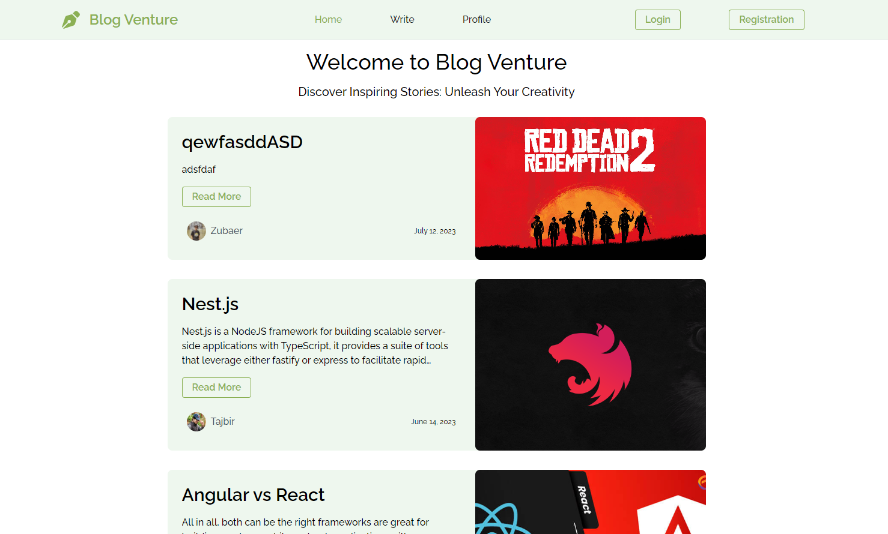
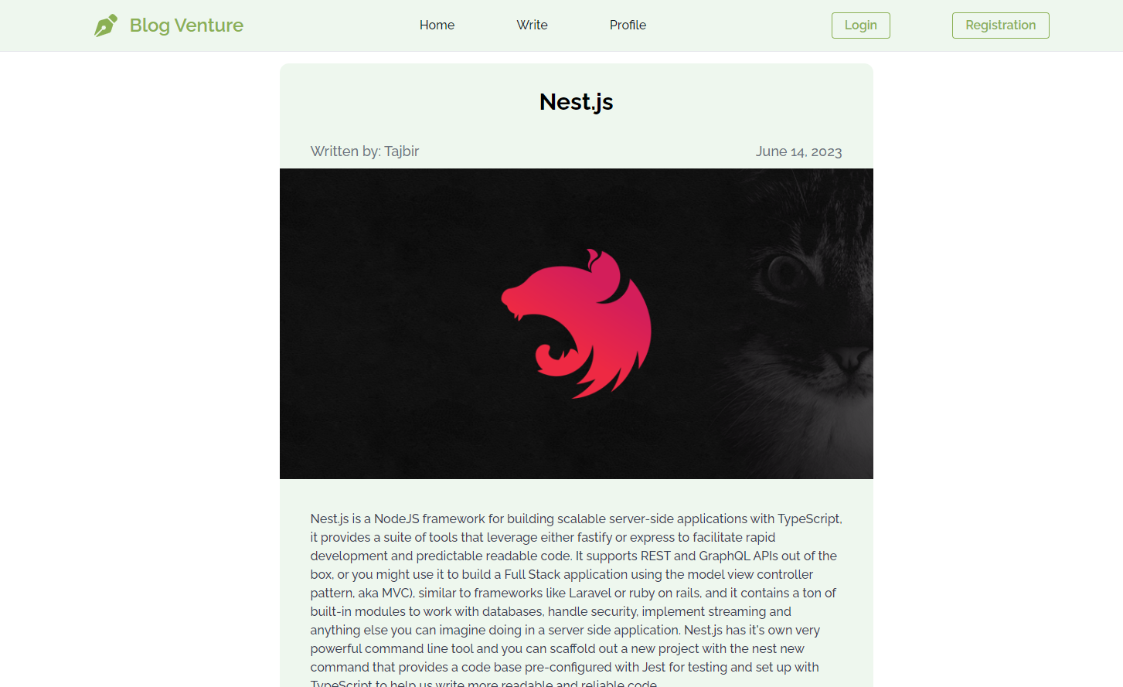
Project Visualization
Home Page
A single blog page

Slide 10
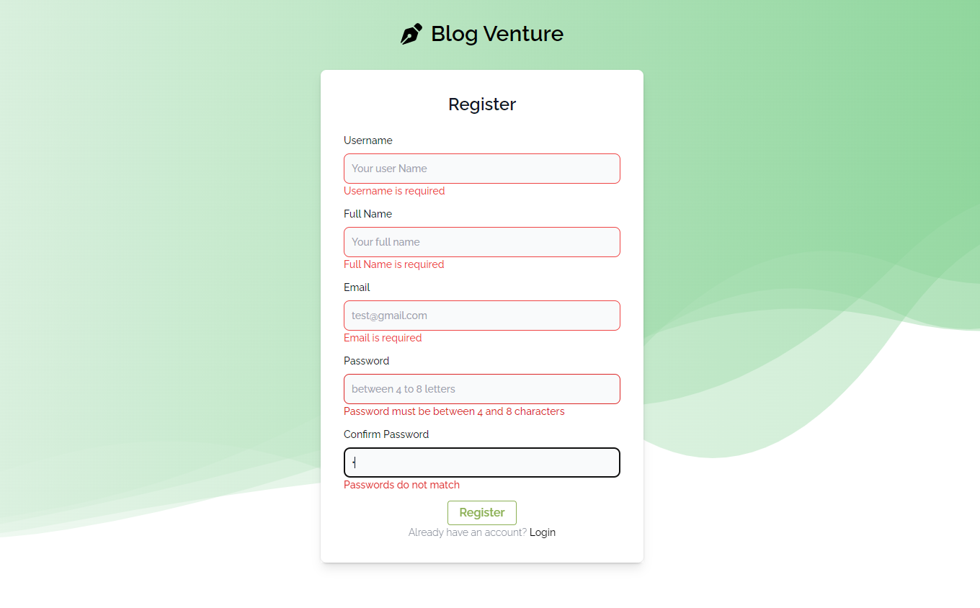
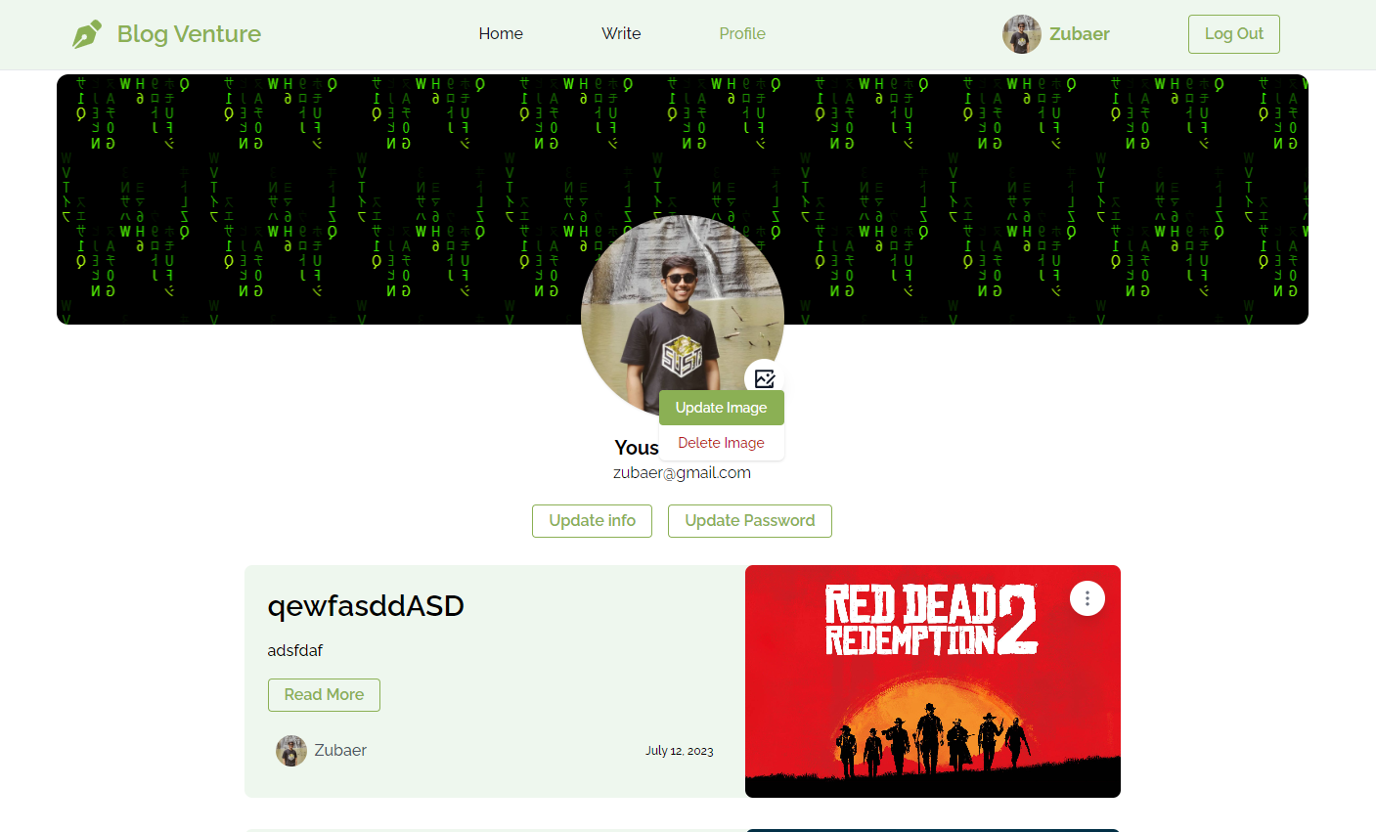
Project Visualization
registration page with validation
Profile Page

Slide 11
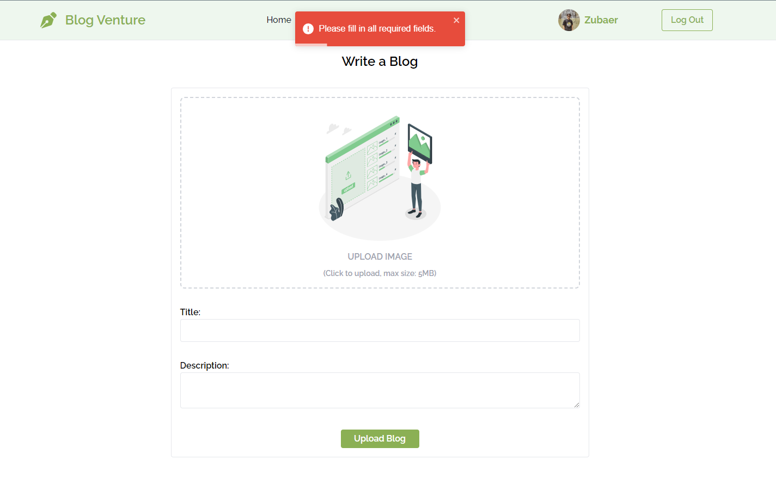
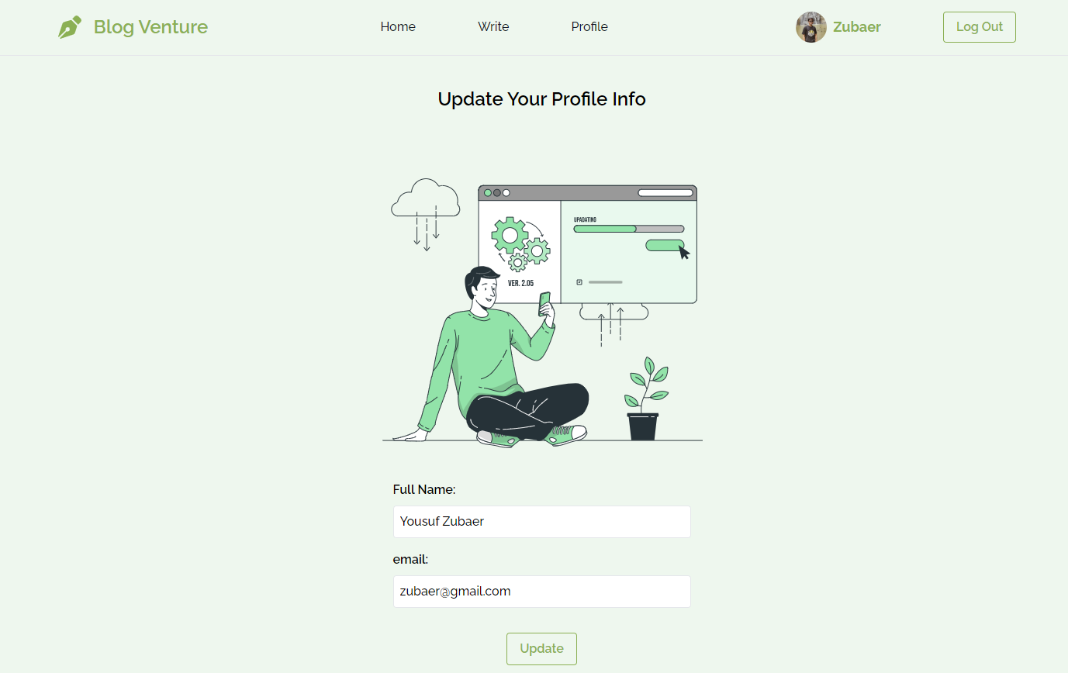
Project Visualization
Write page with validation.
Update profile Info

Slide 12
Group Project :
Beyond The Page

Slide 13
Project Overview
Our intern team of four had the exciting chance to contribute to an ongoing project
a knowledge-sharing and discussion platform for internal use.
Our task was to understand, refactor, make essential changes to the existing code-base and implementing a new feature to enhance its functionality

Slide 14
Project Features
Create and Share Posts: Users can create and share rich content posts with Image.
Tagging System: Users can add tags to posts for easy topic-based searching.
Personalized Feed: Followed users' content appears in a personalized news feed.

Slide 15
Project Features
Comments and Discussions: Engage in discussions by commenting on and replying to posts.
Trending Topics and Recommendations: Get recommendations and trending topic updates.
Search Functionality: Conveniently search for posts by tags or titles.

Slide 16
My Responsibilities
I worked in the backend. Reformatting the existing code-base and Developing new functionality. Tasks i’ve done so far:
Configuration and dependencies fix
Creating issues
Routing
Middleware
User functionalities

Slide 17
My Responsibilities
Follow functionalities
Image functionalities
Content Negotiation

Slide 18
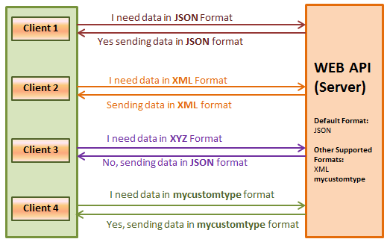
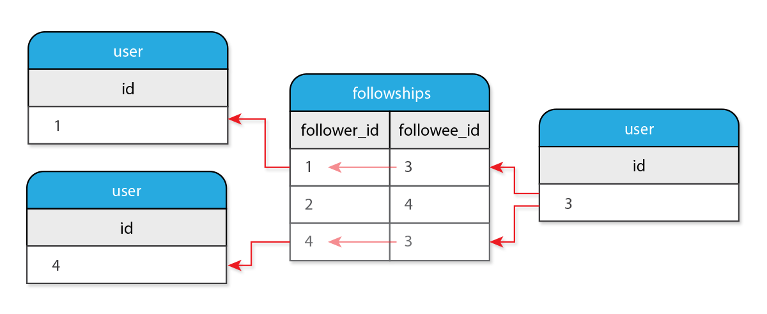
My Responsibilities
Follow functionalities
Content Negotiation

Slide 19



